Slide 1
Self Learning Project
By Michael Chang
Use Google Slides to view the presentation with Speaker Notes:
https://docs.google.com/presentation/d/19uwGqgH9goZbUogFVYLnLJbY8s3srDi_LSo7nHdo37A/edit?usp=sharing
And colab:
https://colab.research.google.com/drive/1kCY_m0ugG8AdLHztV9V50gvrWKwJnKTy?usp=sharing

Slide 2
Goal and Motivation
Motivation: My uncle, who lives in China, is 66 years old and has been smoking since he was a young adult. Although smoking is becoming less and less popular in younger chinese generations, many people from older generations still smoke heavily. My uncle goes through about 2 packs of cigarettes daily. His behavior concerns my whole family and we worry about his health.
Goal: I wish to better understand the relationships between various health markers and smoking habits.

Slide 3
Dataset
Data: https://www.kaggle.com/datasets/kukuroo3/body-signal-of-smoking
Original source: https://www.data.go.kr/data/15007122/fileData.do#tab-layer-openapi
I will use the data from South Korea’s National Health Insurance. During my research, I was unable to find a public dataset of smoking habits of the Chinese population. I chose to work with the South Korean dataset because it is publicly available, accounts for a wide range of bio factors, has a lot of data and is the most complete ( no null or invalid values). Of all the populations in the datasets related to smoking behavior, the South Korean population resembles the Chinese population the most. Therefore, I believe it would be relevant to do our analysis on this dataset.

Slide 4
Methods and Machine Learning Model
Initial data processing using NumPy and pandas
Then, use keras to create a neural network:
Keras is an open-source deep learning framework to help create neural network
We will build a Sequential model with 2 layers
2 layers because it is a good balance between complexity, computational cost, and model accuracy
Use seaborn for plotting

Slide 5
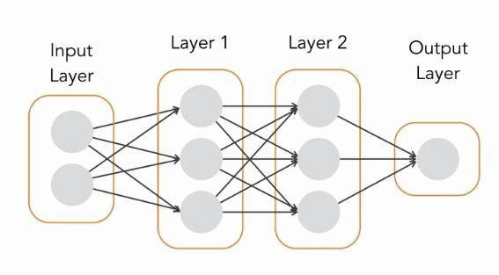
Sequential Model
Linear stack of layers for neural networks
Each layer is connected to the previous
Why choose Sequential Model? Simple, easy to understand and to debug
Notes:
Commonly used in deep learning, the Sequential model is an model architecture that allows to simply add neuron layers in a sequential order to create a neural network. This means each layer is connected to the previous in the linear stack. It provides many benefits. For instance, it is simple to use, widely supported by many CPUs and GPUs, efficient for learning a variety of tasks like linear prediction, object detection, image classification, etc. Full documentation can be found here : https://keras.io/guides/sequential_model/#when-to-use-a-sequential-model

Slide 6
Layers
Fewer layers:
Simpler model, less risk of overfitting
Faster training, lower computational cost
Limited representation capacity of data
More layers:
Captures complex patterns in data, but longer training time and increased cost
Risk of overfitting
Better performance with large dataset
Each layer receives data, transforms it and feeds to next layer
More layers = more depth = more complex model
Layers contain activation functions to introduce non-linearity

Slide 7
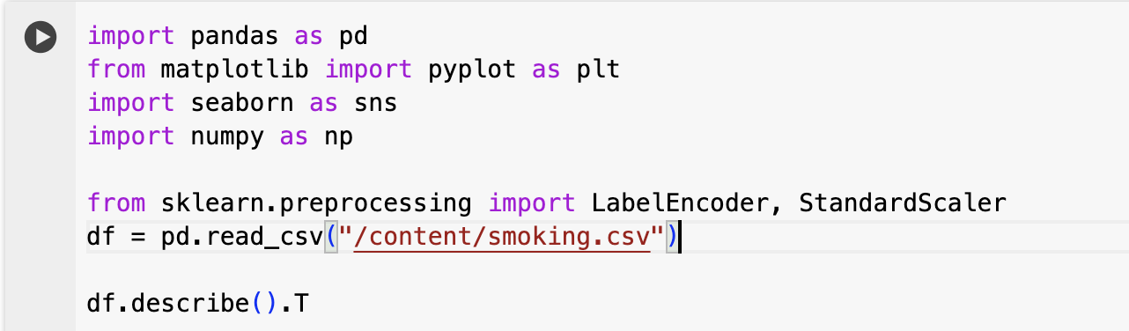
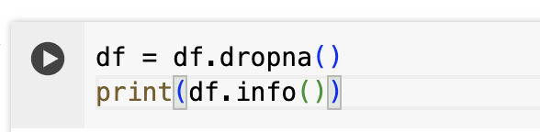
Code
Upload csv data file and use pandas to read in the csv file
Drop rows with missing values as a pre-processing step
Notes:
Follow along here for full code: https://colab.research.google.com/drive/1kCY_m0ugG8AdLHztV9V50gvrWKwJnKTy?usp=sharing You must be signed in with your utexas.edu gmail account to view the code. To run the the colab, make sure to upload the smoking.csv file to the colab files folder. Update the path if necessary .

Slide 8
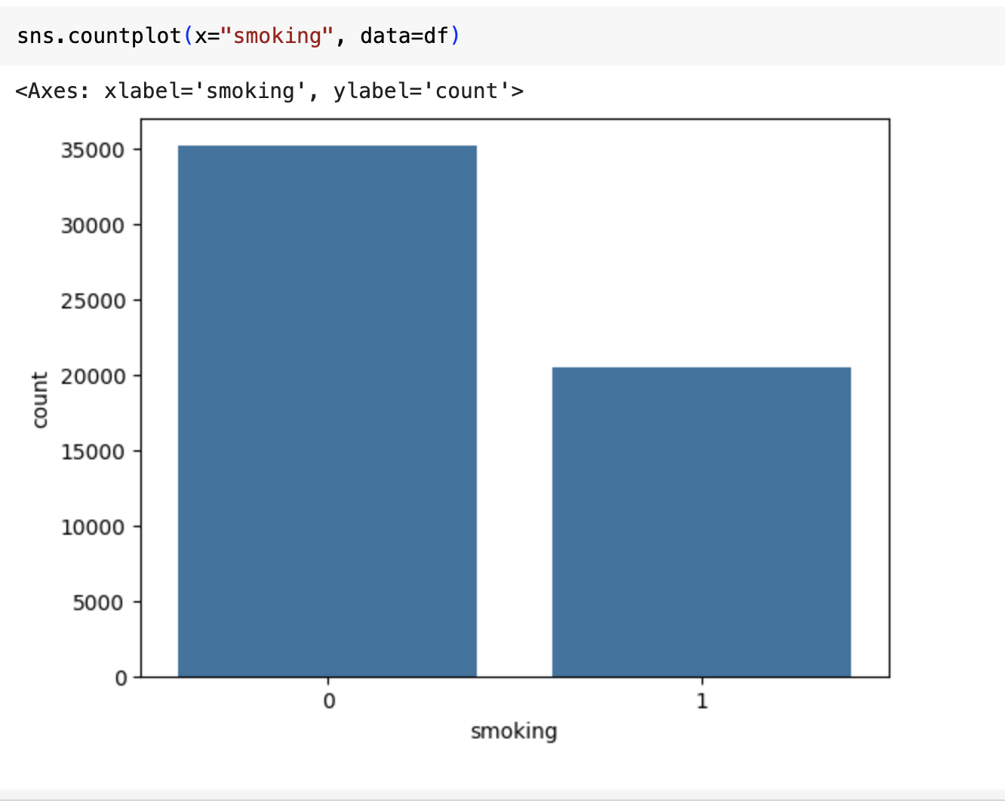
Simple data exploration
Plot the distribution of smoking (encoded as 1) and non-smoking (encoded as 0)
Notes:
Here we are simply exploring the dataset to view some simple statistics regarding the distribution of the samples. In this slide, we are viewing the distribution of smokers vs non-smokers.

Slide 9
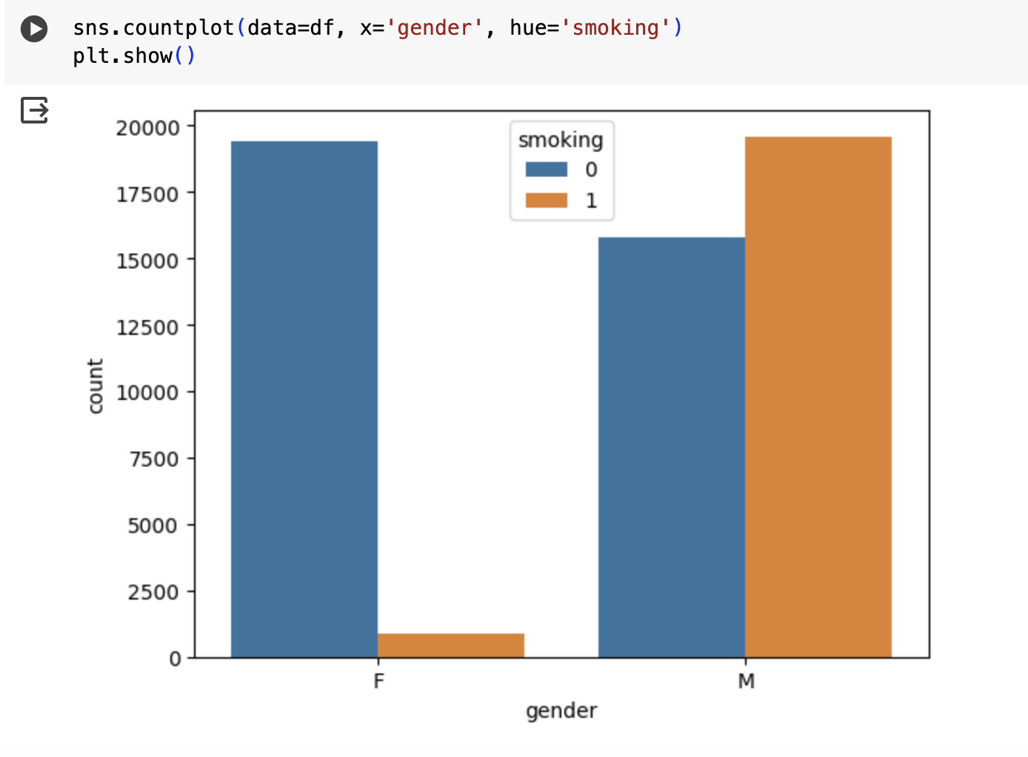
Plot the distribution of smoking (encoded as 1) and non-smoking (encoded as 0) by gender
Notes:
Here, we are further exploring the distribution of smokers vs non-smokers, but now we are further dividing each by gender.

Slide 10
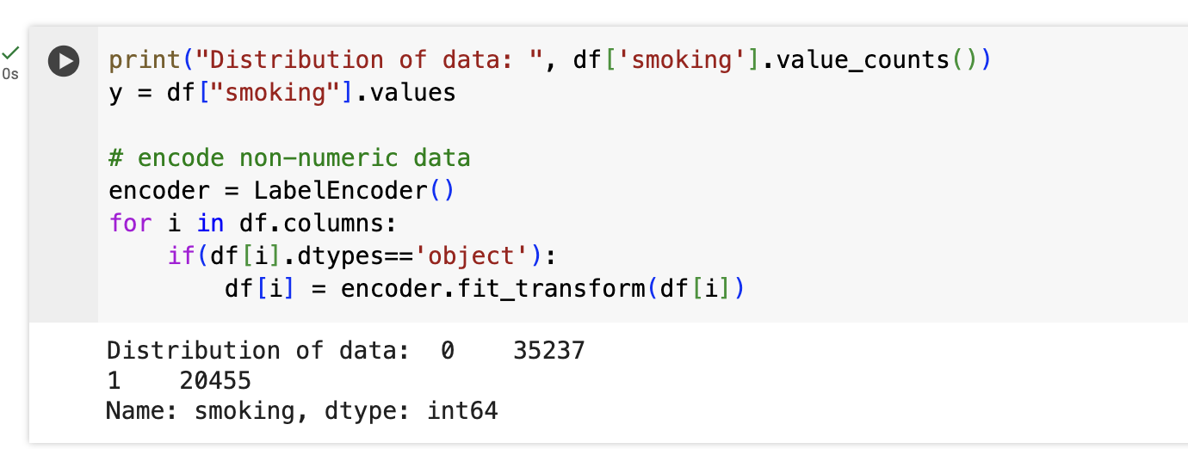
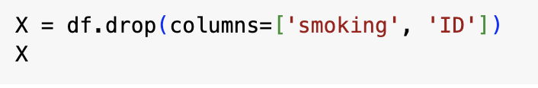
Some of the values are non numeric. Use LabelEncoder() to transform them into numeric values
Prepare a X dataframe without smoking and ID columns. Y is the target, smoking.
Notes:
We are further confirming the distribution of smokers and printing out the numbers of smokers and non-smokers. Next, given that some entries in the dataset are non-numeric (categorical), we must use an encoder to transform them into integers. This is called encoding. Encoding refers to the process of transforming categorical values into a numerical format to facilitate model training. This is because most machine learning algorithms are designed to work with numeric values. Without encoding our categorical values, the algorithms will not work. In our code, we need to encode the entries where the type of the value is ‘object’.
Next, we begin splitting our data to prepare it for training. First, we extract our y, which is our target column, by selecting the ‘smoking’ values from our dataset. We then get X by dropping the target column ‘smoking’ and ‘ID’ (because it is not informative for our training) .

Slide 11
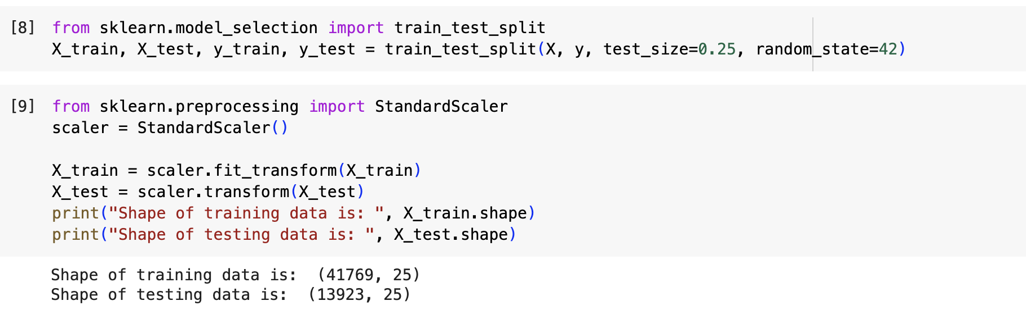
Prepare the training and testing sets. We are using a 75-25 split for validation
Scale the X_train and X_test to normalize the data while preserving the distribution shape. Also increases the model performance and speed
Notes:
Using train_test_split, we are splitting our data to get training and testing data. These will be used later for model training.
StandardSclaer is then applied on our data to normalize our data. This helps our model’s performance and computation efficiency . More about StandardScaler: https://scikit-learn.org/stable/modules/generated/sklearn.preprocessing.StandardScaler.html

Slide 12
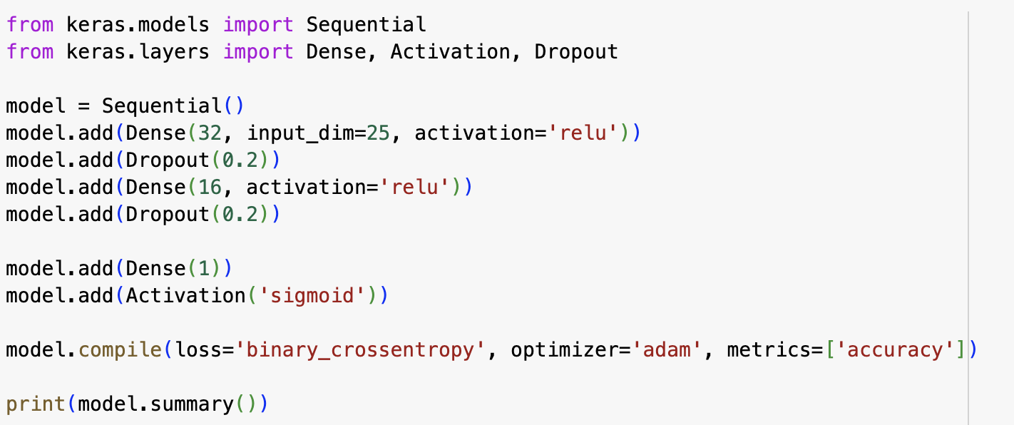
Building our Sequential neural network with 2 Dense layers
In between each layer, we add a drop out of 20% of the data. Drop out deactivates randomly some of the neurons in the layer. This reduces risk of overfitting and improves performance on unseen data
Notes:
More about the Sequential model from the official keras documentation page: https://keras.io/guides/sequential_model/
Our activation function chosen in Dense layers is relu: it is simple to use and compared to other activation functions, helps our model compute faster and converge faster.
The final output layer is sigmoid since we want to classify our output as 0 (non-smoking) and 1 (smoking). Sigmoid is very suitable for this kind of classification, called binary classification, since this function can convert all outputs between a probability of 0 and 1. Then, using a threshold and these probabilities, we can classify our results and make predictions. Then, we compile our model with a commonly used loss function in binary classification, binary_crossentropy. We also use the accuracy as our evaluation metric

Slide 13
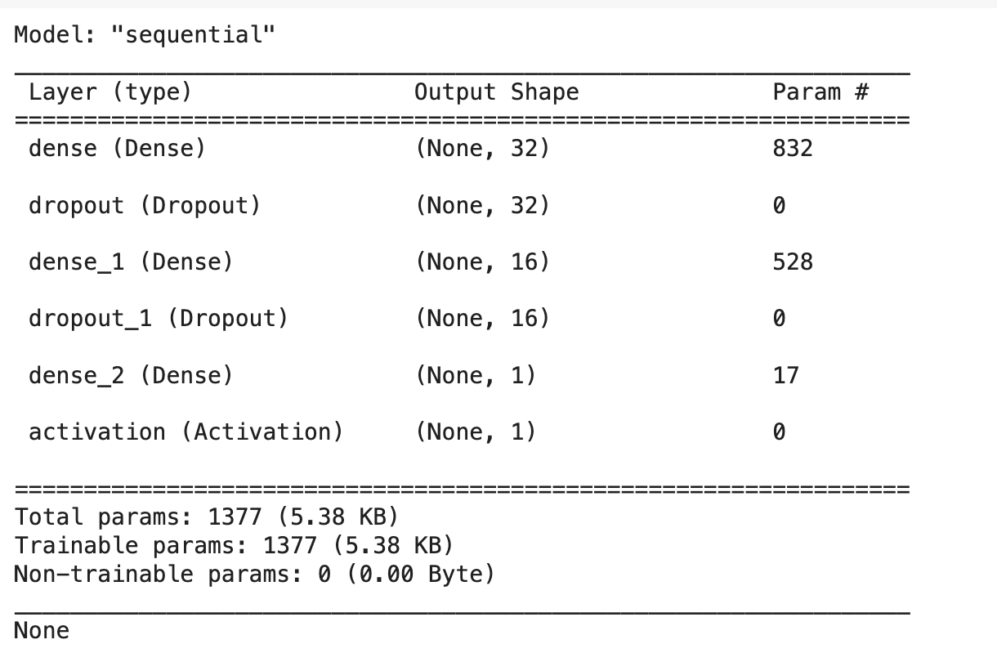
Notes:
This is a visual representation of our model and its layers.

Slide 14
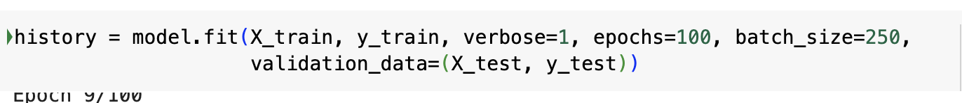
Start training the model with 100 epochs in data batch size of 250 samples per epoch
Given the large size of our data set ( 55692 entries), we can use a larger batch size, which can help increase model training speed and can help reduce noise.
Notes:
The line used in this step is relatively common/standard across data science. History encapsulates different metrics such as accuracy, loss, etc. : https://keras.io/api/models/model_training_apis/ or https://wandb.ai/wandb/s2c/reports/Plotting-Keras-History-Using-Weights-Biases--VmlldzoxNTI0NDU for further reference.

Slide 15
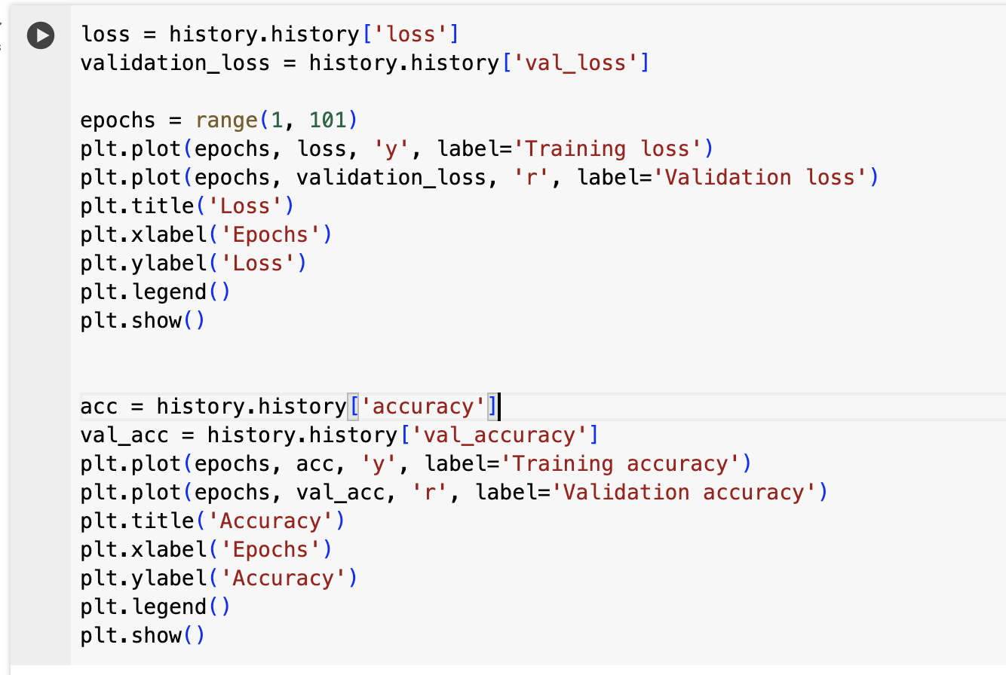
Plot the results
Notes:
This slide shows code to help plot our results

Slide 16
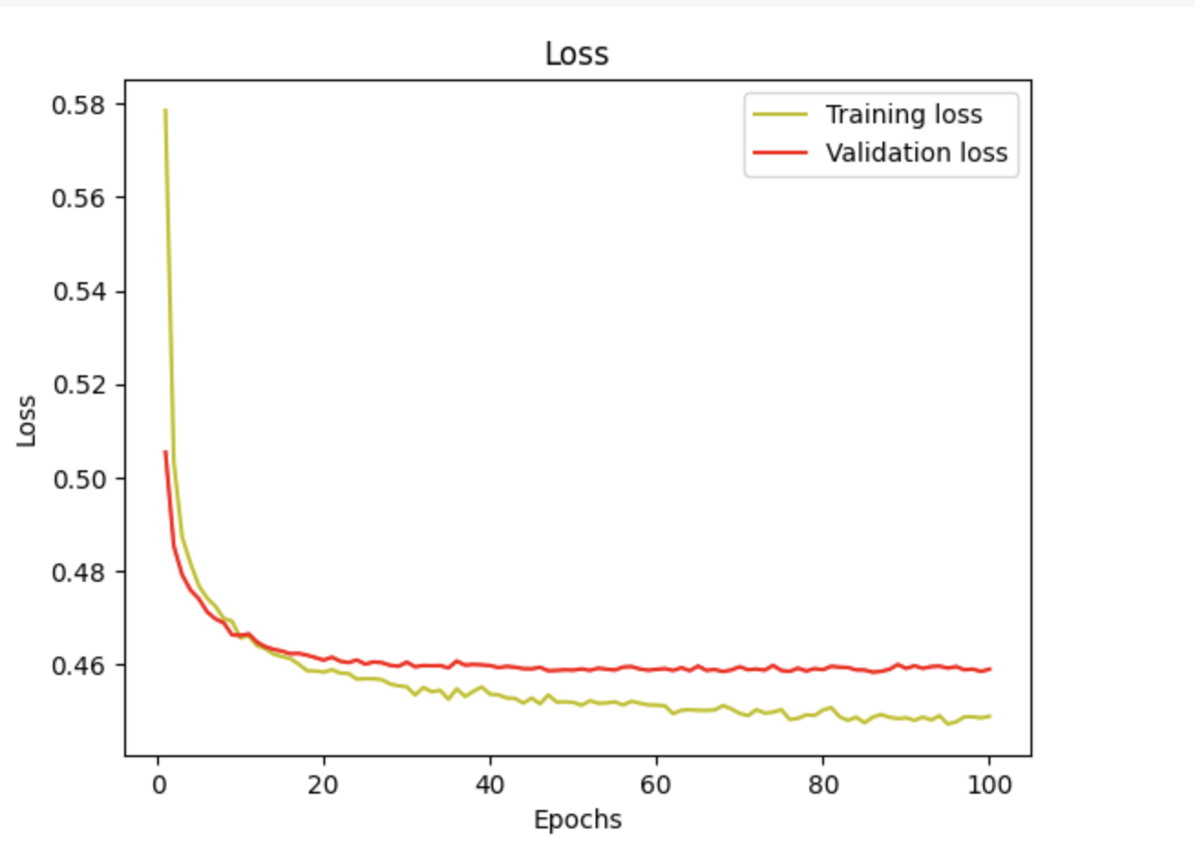
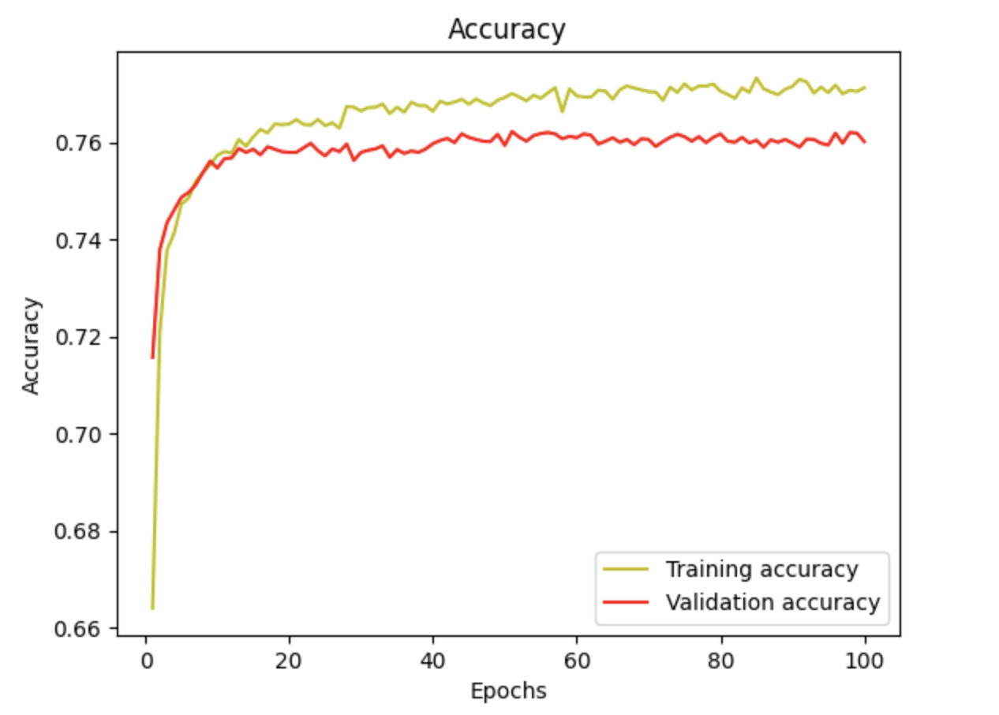
Notes:
The respective loss and accuracy graphs. Each graph shows the comparison of the training and validation curves.

Slide 17
Analysis of loss plot
After all the epochs, the validation loss curve is above the training loss curve. The two curves are close to each other. The validation loss curve plateaus at around 0.46. The training loss plateaus around 0.44.
Our curve shows that the loss is high in the earlier epochs. This is expected since our model has only begun to learn. Then, it gradually decreases, which indicates it is updating itself to learn the data.
Further analysis in speaker notes.
Notes:
The training and validation loss at the end of training is quite high. Usually, if these values are low, it indicates that the model is performing well and learning the data. In our instance, the value is pretty high. This relationship between our curves indicates that model seems to be underfitting. This means it is too simple and not capturing enough patterns in our data to make accurate predictions on unseen data.

Slide 18
Analysis of accuracy plot
The validation curve is under the training curve and plateaus at around 0.76 and 0.77 respectively. The accuracy is low initially and increases with each epoch. This indicates our model is learning and updating itself to improve its accuracy
Further analysis in speaker notes.
Notes:
The accuracy plot validates our previous conclusion that our model is underfitting since the curves plateau at a relatively low value. The gap between both curves is small which indicates that the model is not overfitting and more likely it is not capturing enough patterns in our data.

Slide 19
Model improvements
To improve our model, we can consider several options: increasing complexity, improving our dataset quality/ reduce noise, adjusting our hyperparameters.
Increasing our model’s complexity may help capture more patterns in the data and improve the accuracy,
Improving the dataset quality means the training data will better represent the true population smoking patterns, which in turn our model can use to make more accurate predictions.
Finally, we can test different hyperparameters ( batch size, # of epochs, optimizer settings, etc.) to find the optimal configuration for our model.

Slide 20
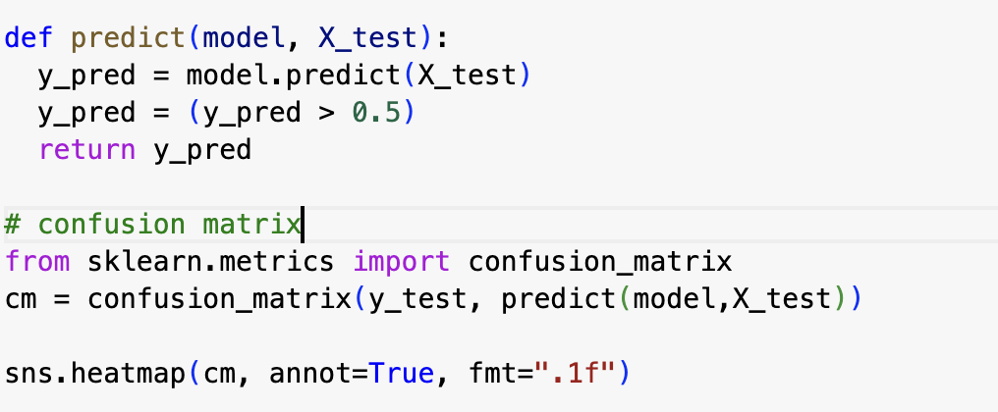
Confusion Matrix
We create a helper function to make a predictions and set a confidence threshold of 0.5. We then plot a confusion matrix. For full documentation of a confusion matrix, read https://en.wikipedia.org/wiki/Confusion_matrix#:~:text=In%20predictive%20analytics%2C%20a%20table,false%20positives%2C%20and%20true%20negatives.

Slide 21
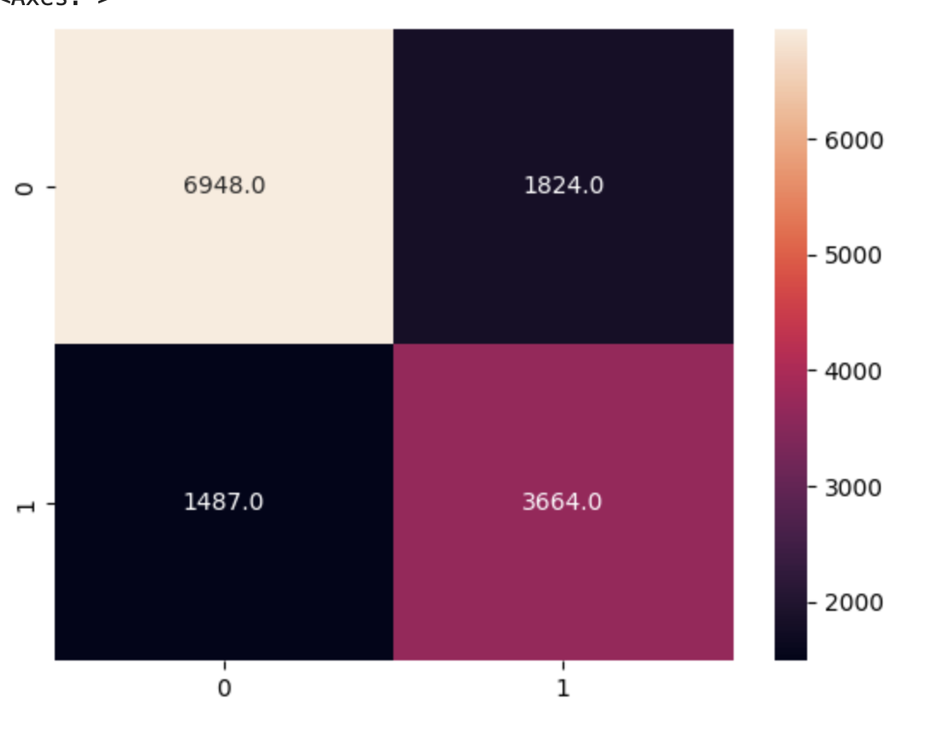
Notes:
The confusion matrix helps evaluate the performance of our classification. It show he counts of true positive (TP), true negative (TN), false positive (FP), and false negative (FN) predictions. Our model predicted correctly as negative 6948 samples and incorrectly 1487. It predicted correctly as positive 3664 samples and incorrectly 1824 samples.

Slide 22
Conclusion
In conclusion, we used keras to build a Sequential neural network to train our model. After training our model, it seems to be underfitting the data. While the current accuracy is promising, we should look into making further improvements to improve our model’s accuracy.

